Slide 1
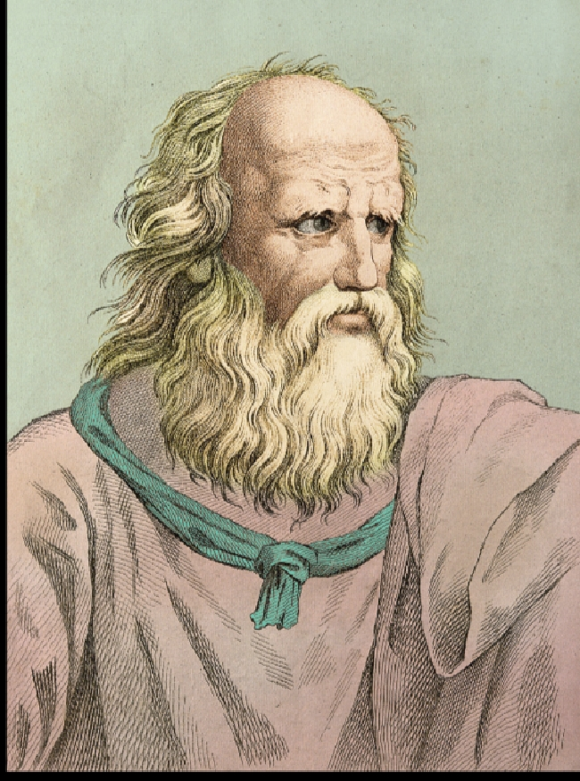
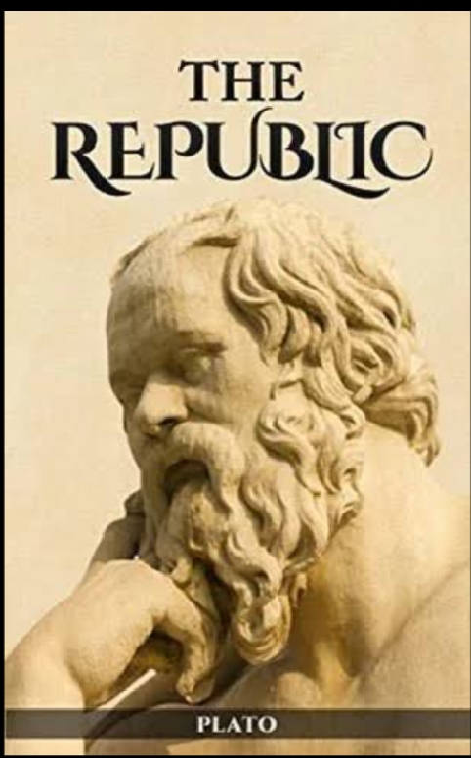
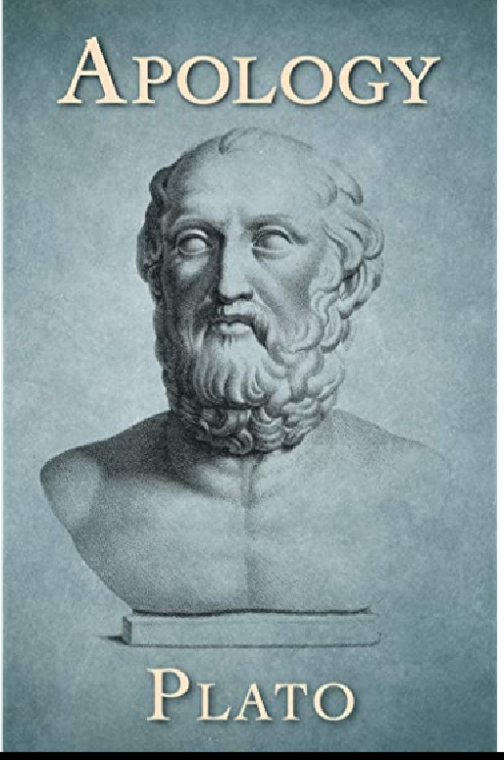
প্লেটো (৪২৮-৩৪৮ খ্রীঃ)

Slide 2
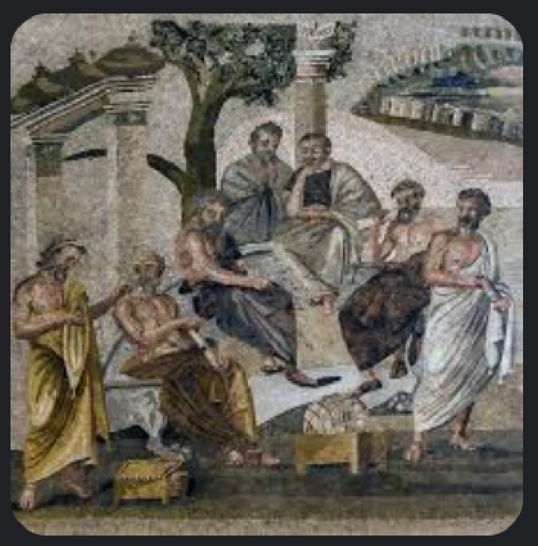
Platonic Academy

Slide 3
Theory of epistemology
Sense perception is not knowledge
Right opinion is not knowledge
Ture believe is not knowledge
Real
Infallible

Slide 4
ধন্যবাদ

